Slide 1
SPIDERS
(with a Y)

Slide 2
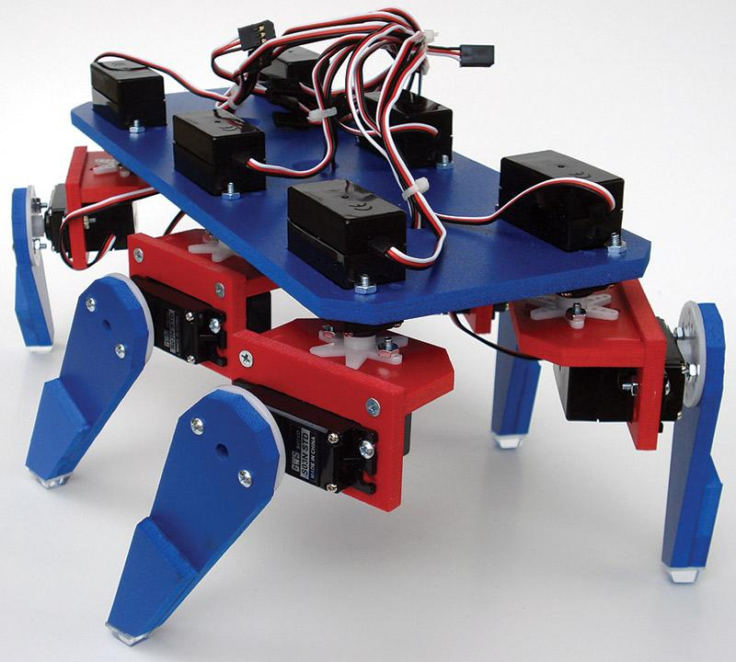
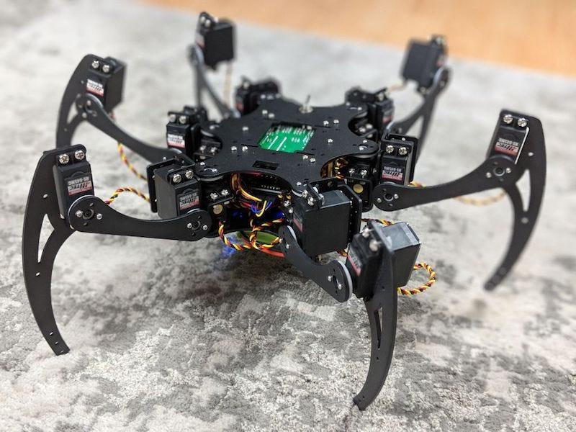
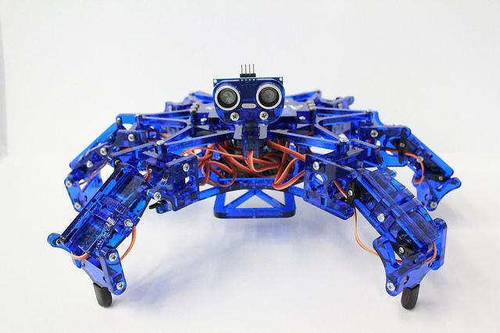
WHAT IS IT
A hexapod spider robot can take many forms

Slide 3
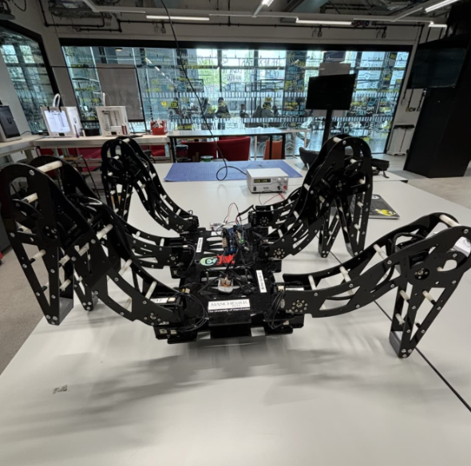
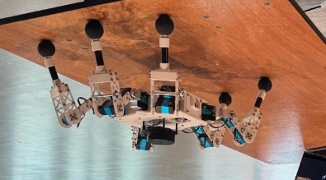
WHAT WE’VE DONE

Slide 4
WHAT WE’VE DONE
You aren’t making this

Slide 5
WHAT YOU’RE DOING
Simple robust designs
6-legs, medium sized
Up to three servos per leg
Focus on making a spider that can walk on its own
Give it your own flair and do what works for you

Slide 6
WHAT’S AN EXAMPLE

Slide 7
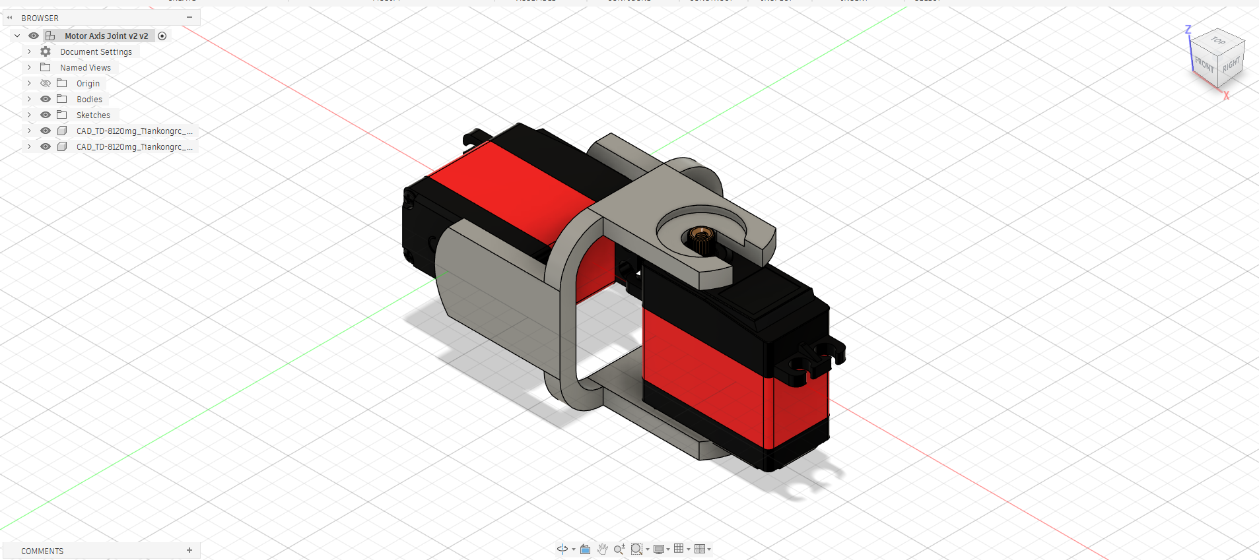
HOW IT WORKS
CAD Software
Up to you, but we strongly recommend Fusion360
Make sure to use your university e-mail when registering

Slide 8
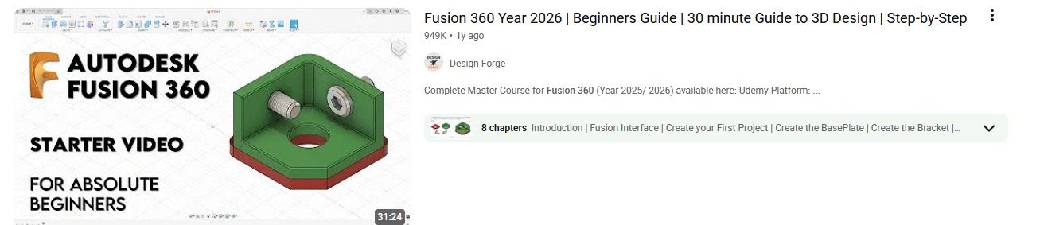
Create sketches, set dimensions, and extrude them
Work in a hub with a team to share parts
Parts should overlap and connect to form the complete model

Slide 9
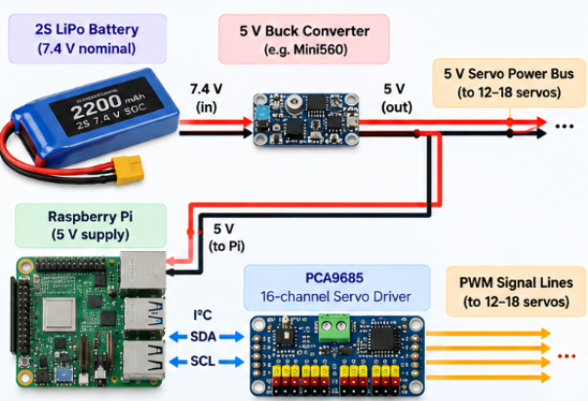
Basic Design
Logic unit can be variable (Raspberry Pi,
Arduino, ESP32, etc)
Make sure every part can only draw up to its
needed current and voltage

Slide 10
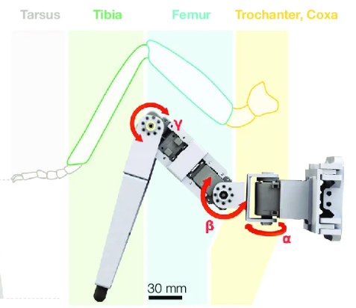
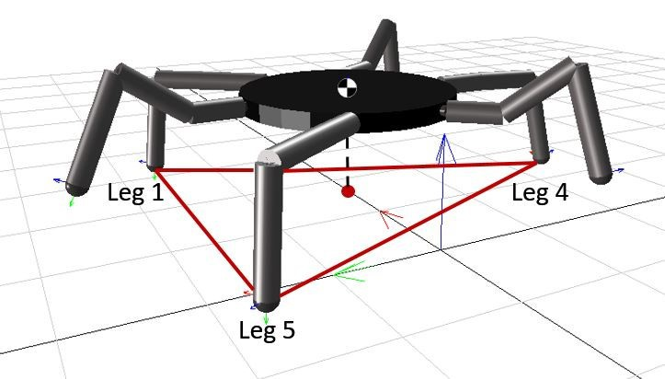
Three-servo design:
First servo controls horizontal rotation, second servo controls
hind leg rotation, last servo acts as knee
Three legs are touching the ground at any given moment to provide stability (gait)

Slide 11
Key warnings
Keep the chassis and overall size under ~25 cm to ensure it
can fit for the printers
Have an idea of the overall placement from the start
(recommended to draw a sketch)
Leave space for wires
Ensure screw hole sizes are right from the start
Be flexible (things aren’t going to go right)

Slide 12
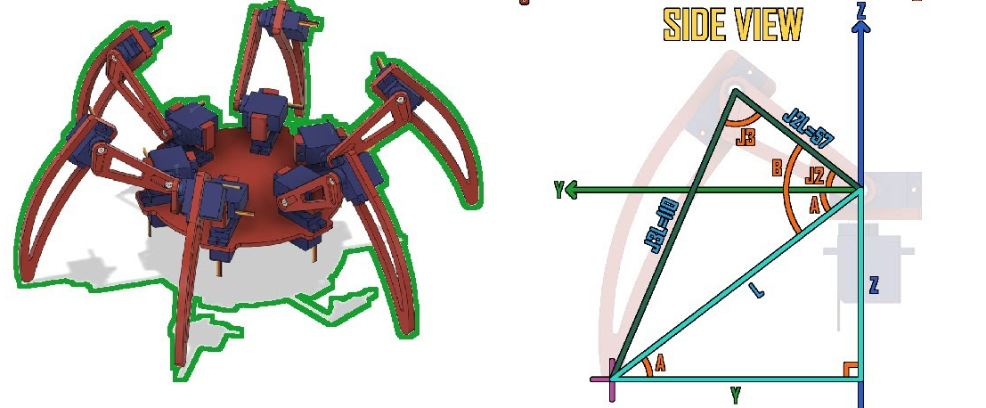
Programming
Multiple viable methods
(inverse kinematics,
sensors, etc)
Focus on just getting it
to move
Stability is key
It’s good to know from
the start, but worry about
it later
Programming language: Up to you, but almost certainly C++

Slide 13
What to start with
Download Fusion360 (USE UNI EMAIL FOR STUDENT LICENSE)
Form teams of 3 to 5 (don’t work alone)
Go home and get to grips
Have fun or else this project is dead (cry)

